Slide 1
The artificial green thumb
Automating the watering of houseplants by the usage of fuzzy-logic with various environmental sensors

Slide 2
The idea
Those who lack the “green thumb” often find themselves forgetting to water their plants.
Or…
  they show their plants too much love and overwater it.
  They water the plant with “bad” water.
All of above scenarios lead to dead plants…
To help solve this issue, I have created a simple system to automate* the watering process of plants.
* The water reservoir still has to be filled manually, by hand every now and then.

Slide 3
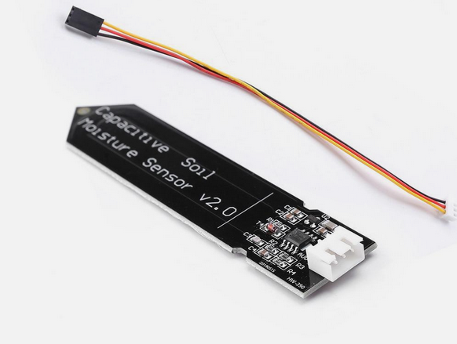
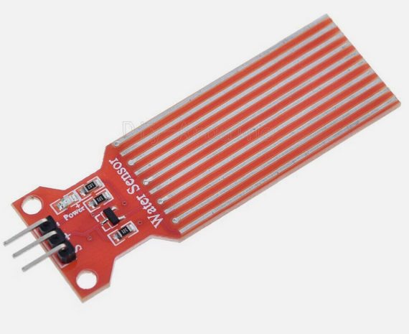
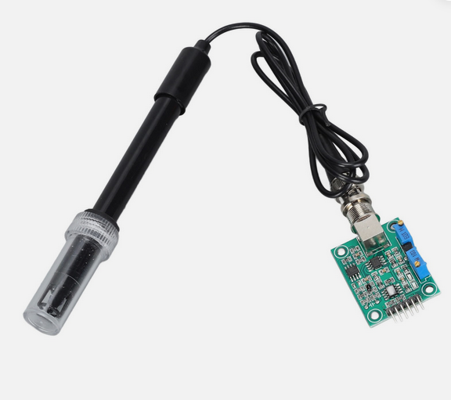
The hardware
The “brain” of the project is an Arduino Nano.
The “muscle” of the project is a ~4.5W Diaphragm pump.
The “fingers” of the project are environmental sensors:
  (Capacitive) Soil moisture sensor.
  (Capacitive) Water level sensor
    1x Used to measure the water level in the water reservoir.
    1x Used to detect the presence of water at the bottom of the plant pot.
  PH probe + sensor board

Slide 4
The (fuzzy) logic
All sensors used are analog sensors:
  Read values range: 0…1023
  Transformed into more readable terms/states:
    “Too low”, “Dangerously low”, “OK”, “Dangerously high”, “Too high” and “Invalid”*.
Each sensor value is transformed according to its’ use case.
Not every sensor uses the full range of states (e. g: The water detection sensor only ever says “too low” or “ok”, meaning, there is no water, or there is water detected, no in-between)
The goal is simple, it is to answer the question, based on all sensors current state, “do I turn the pump on, watering the plant, or do I keep it off”.
* The invalid state is only for exceptional cases, e. g: Impossible values somehow getting read.

Slide 5
The (fuzzy) logic (contd.)
The goal is to decide whether to turn the pump on or keep it off (Until the next decision).
The ruleset consists of five rules:
  If the PH is either too low, or too high, the pump stays off.
  If there is no more water in the reservoir, the pump stays off.
  If any sensor reports an invalid state, the pump stays off.
  If the soil moisture is anything other than soaking wet, and there is no water detected at the bottom of the pot, the pump can go on.
  If the soil moisture is bone dry, even if there is water at the bottom, the pump can go on.
  … All other cases keep the pump off.

Slide 6
The ugly
When trying to complete the project various issues arose:
  Multiple burned parts…
  Botched solder jobs lead to using a prototyping breadboard for the final version.
  The PH probe or sensor bought is faulty…
    So (for now) the PH value read in the code is hardcoded to always indicate “OK”.
  The pump can not be powered by the 3.3v/5v Arduino, it requires 12v, and more amps than the Arduino can provide…
    Currently I use a benchtop power supply, but that is only provisional/temporary.
    For proper usage it’ll need to be replaced with something more “handy” in the future, like a USB power supply

Slide 7

The result

Slide 8
The future?
To improve the usefulness of the system, various upgrades (and fixes) are on the roadmap:
  Make the system ‘permanent’ by properly soldering all parts together, instead of being a breadboard prototype.
  Either fix, or buy a new PH sensor.
  Add air humidity, temperature and turbulence/flow environmental sensors:
    The goal: Estimate the state of the plant health:
      Through combining the existing and new sensor states, estimate whether the plant is growing healthily:
        Is it at risk of molding/rotting? (Humidity, temperature, pressure)
        Is it getting heat stressed? (Temperature, humidity)
        Is it drying out? (Humidity, moisture)

